Slide 1

DDSAnalytics
By: O’Neal Gray
Notes:
Dear CEO and CFO of Frito Lay,
My name is O’Neal Gray with DDS Analytics and I am pleased to present to you the findings of our data analysis. I have conducted an analysis of existing employee data to identify factors that contribute to turnover and to build a model to predict attrition.
Through our analysis of the dataset provided, we have identified the top three factors that contribute to turnover which will be discuss in the presentation. Our findings are backed up by robust experimentation and appropriate visualization, and we have also identified job role-specific trends that may exist in the data set.
We have leveraged data science for talent management and have successfully built a model to predict attrition. I have also developed an RShiny App to visualize attrition and other variables.
We believe that our findings and models can help Fritolay gain a competitive edge over its competition and assist in retaiing employees. We hope that this project will serve as a valuable resource for your talent management solutions.
Thank you for your time and consideration.

Slide 2
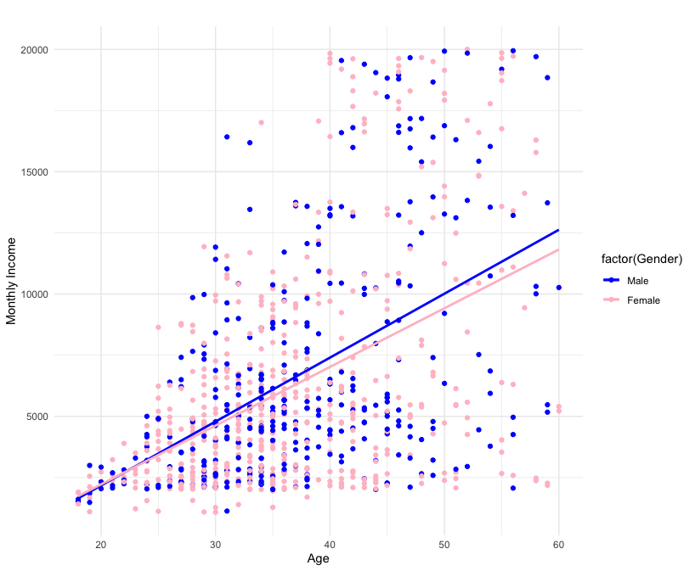
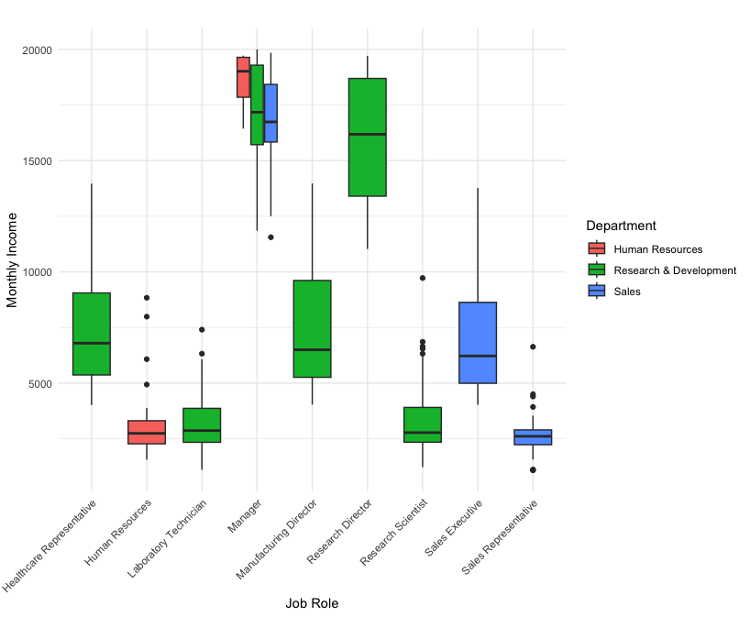
Exploratory Data Analysis
Age Vs Monthly Income by Gender
Job Role vs. Monthly Income by Department
Notes:
On our first chart to the left we can see that male and feamles make the same monthly income to about age 30, and the the spread starts to widen. On our other chart we looked at monthly income per role with the heist being in the manager position or research director.

Slide 3
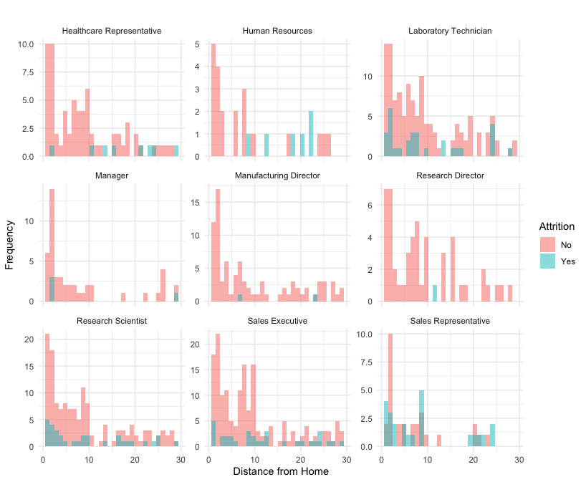
Distance from Home vs. Attrition by Job Role
Notes:
This plot shows the distance from home and the attrition rates broken out by role in the company.

Slide 4

Top three factors that contribute to turnover
Monthly Income
Age
Total Working Years
Notes:
We used the Naïve Bayes model to find the top three factors that contribute to turn over which were -→ read them

Slide 5
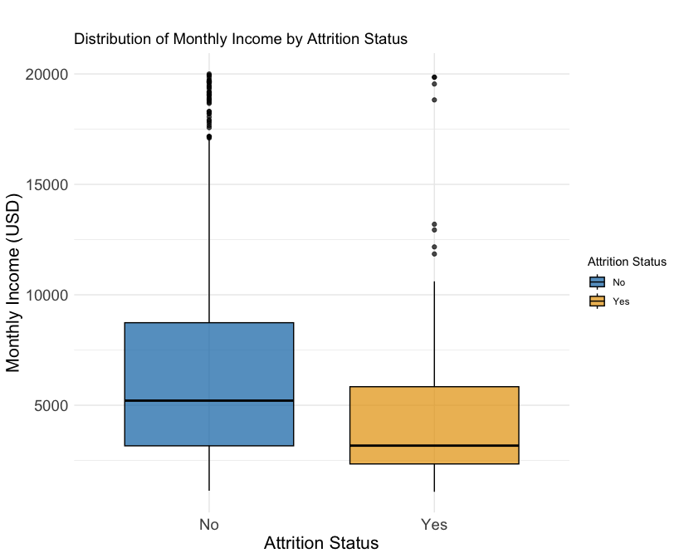
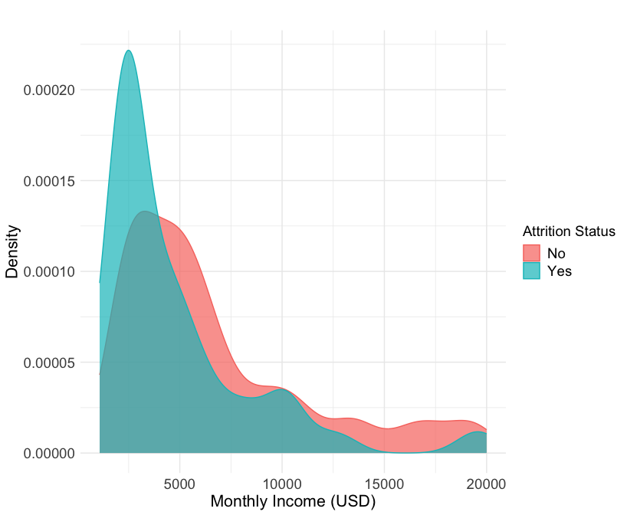
Attrition and Monthly Income
Notes:
As you can see in both charts the mean monthly income was less for the people who left the company than those who stayed. Backing up what we found with monthly income being the #1 contributor to people either staying or leaving the company.

Slide 6
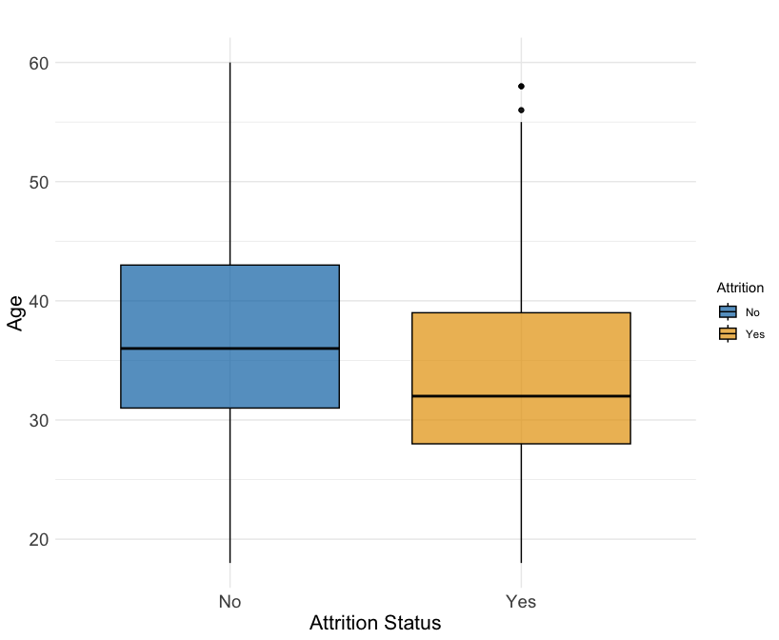
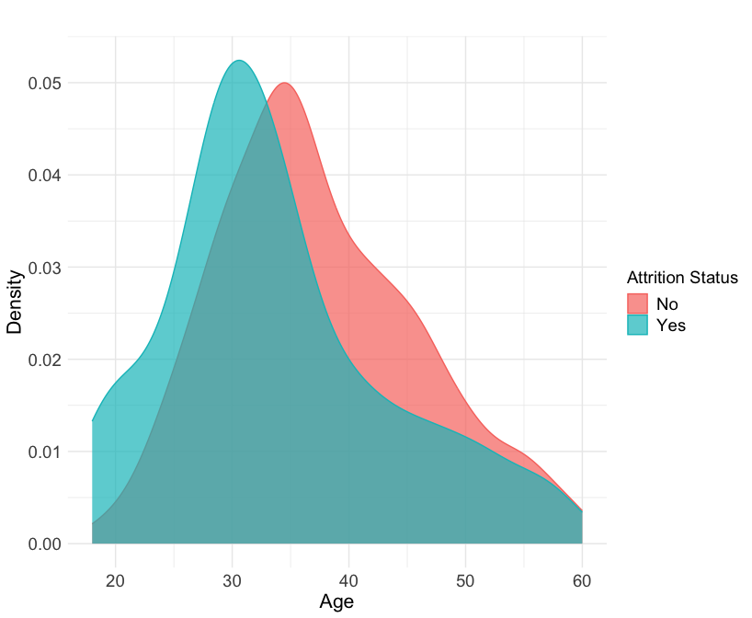
Age by Attrition Status
Notes:
AS you can see in the chart the people who are leaving the company tend on average to be younger.

Slide 7
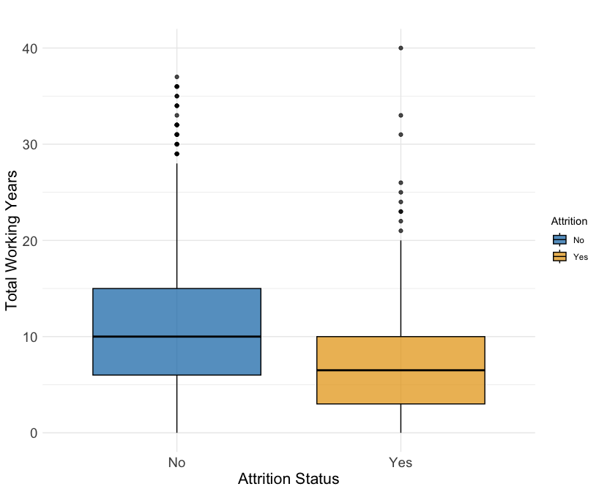
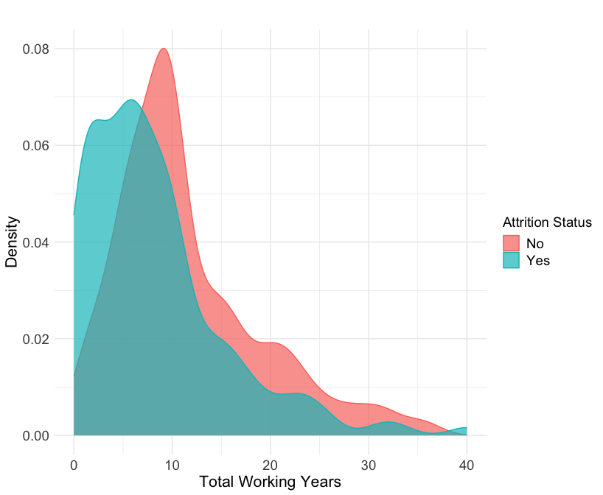
Total Working Years by Attrition Status
Notes:
This one I found interesting as the people who work longer hours are statistically shown to stay at the company at a higher rate.

Slide 8
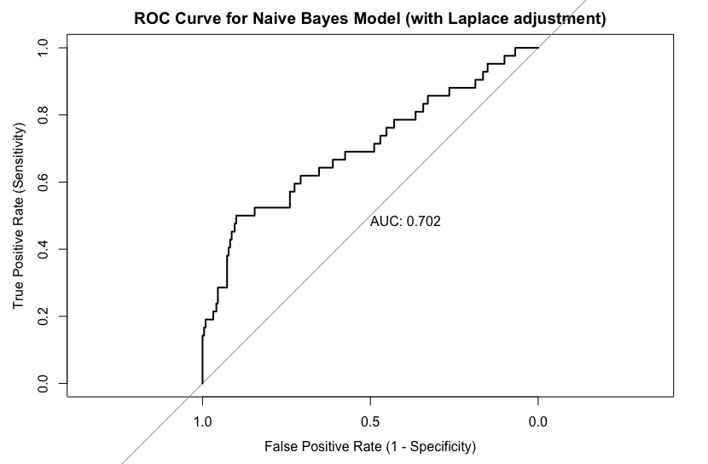
Predicted Attrition Rates
We utilized a Naïve Bayes model to derive the predicted attrition rates, where an adjusted Laplace value was incorporated to increase model sensitivity from an initial value of 50% to a more desirable 53%. The model results are presented below, highlighting the improved performance resulting from the adjustment made.
Accuracy | 79.31%
Sensitivity | 52.38%
Specificity | 84.48%
Notes:
For the dataset that you all provided CaseStudy2CompSet No Attrition.csv we calculated the attrition rates with a 79.31% overall accuracy using the Naïve Bayes model. We made adjustment to the Laplace value to increase sensitivity from 50% to 53 %. Our specificity was at 84.48% for our model.

Slide 9
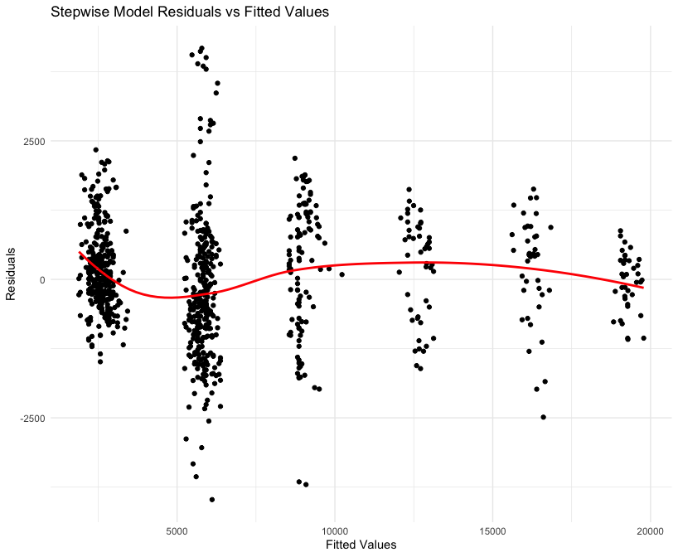
Predicted Monthly Incomes
I applied three linear regression models (Forward, Backward, and Stepwise) to predict the monthly income in the CaseStudy2CompSet No Salary.csv file. The Stepwise model outperformed the other models with the lowest RMSE (1056.361) and highest R-squared (0.9473645) values. The models were compared using a 10-fold cross-validation analysis, and the results of each model's RMSE and R-squared values are documented below.
 | Model | RMSE | Rsquared
1 | Forward | 1057.128 | 0.9470017
2 | Backward | 1067.237 | 0.9452826
3 | Stepwise | 1056.361 | 0.9473645
Notes:
For your data set CaseStudy2CompSet No Salary.csv we ran it with three linear regression models (Forward, backward and stepwise) to predict the monthly income. We choose to use the stepwise model as it outperformed the other models with the lowest RMSE at 1,056.36 and the highest R Square at .9473. We compared the models using a 10 fold cross validation analysis.

Slide 10
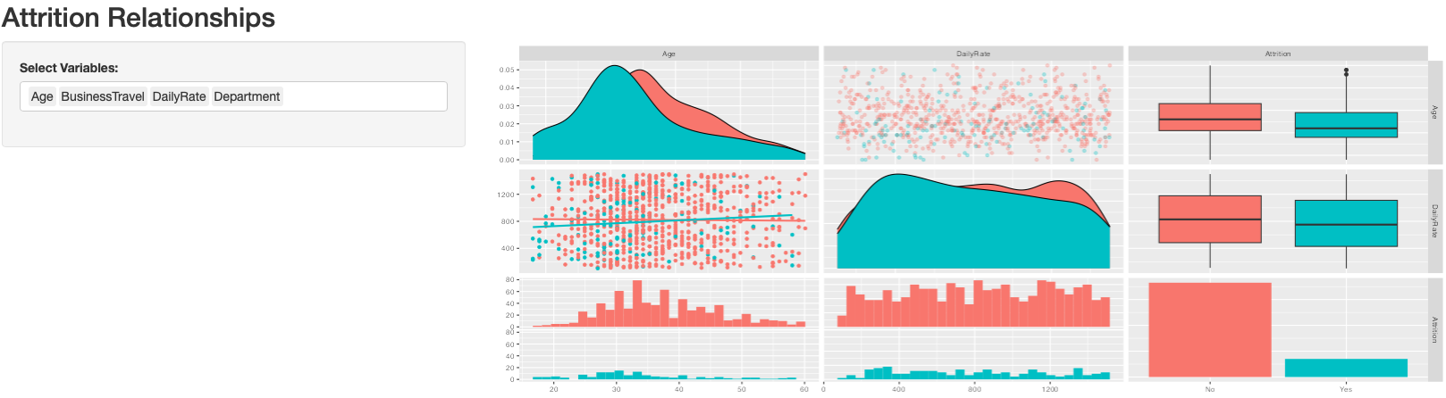
R Shiney App
The Shiney application creates scatter plot matrices to show the relationships between variables(user-selected) and employee attrition.

Slide 11

Conclusion
Please reach out if you have any questions or if you need anything else.
O’Neal Gray
214-724-2020
ogray@smu.edu

